Slide 1
Artifiial Neural Networks to Predict Fermentation Yield
John Abel, Earl St-Sauver, Kimberly Stachenfeld, Jay Stotsky
November 15, 2012
ChBE 160

Slide 2
Objective
Use artificial neural networking to model fermentation process, particularly output variables which are difficult or impossible to measure using on-line sensors in real time.

Slide 3
Background
Unique advantages
Efficiently predict nonlinear processes
Input nodes - used to distribute only
Hidden nodes - "black/grey box"
Output nodes
Apply internal node calculations only to hidden nodes
Time delays
Does not require previous knowledge of the system's relationships, ANNs "learn" from data

Slide 4
Modeling Yeast Fermentation
Training data was generated from an ODE model of the yeast process.
The results of the ODE model are taken as the "actual" model
A genetic algorithm selected weights to minimize the difference between the outputs of the artificial neural network and the ODE model

Slide 5

Neural Network Model
Feed-forward multilayer perceptron
Uses sigmoidal activation function:
Three input nodes, one hidden layer of 6 nodes (plus bias) with delay, three output nodes with a delay
Bias inputs added in each layer
Genetic algorithm-optimized weights, uses random mutation to prevent model from too easily becoming "stuck"

Slide 6
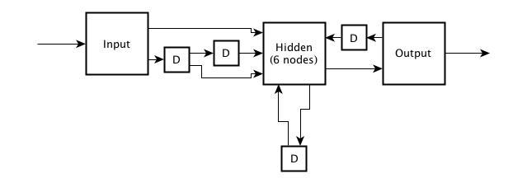
Neural Network Architecture
Hidden nodes optimized to allow for adequate learning, but avoid over-training.

Slide 7
Generalizability vs. Recall
The pattern of error between the predicted and actual metabolite concentrations for the training data set and the novel data set are similar
The model is therefore recall-limited
That is, the generalization is nearly as good as permitted by recall

Slide 8
Weight bounds – unique differences
We set the bounds on the weight to be [-10, 10] by default
For time-delay weights, we limited the range to [-1.5, 1.5]
Thus, the effects of time-delayed inputs are secondary to that of parameter inputs, which should carry more information
Since the search space is so large, limiting the range of time-delay weights dramatically improved the speed, accuracy, and consistency of the model

Slide 9
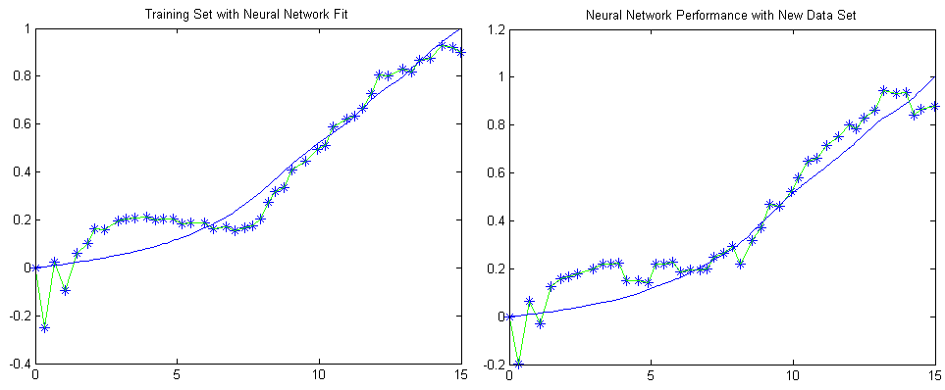
Cell Mass Concentration
The above plot shows the ANN predicted and actual values of cell mass concentration throughout the culture. The data set on the right was the set used to train the neural network. The plot on the left shows the performance of the neural network on a different data set. Correlation Coefficient 0.9015

Slide 10
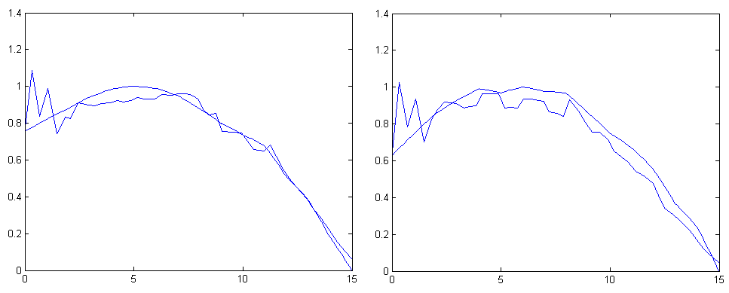
Substrate Concentration
Note that the network is capable of predicting the outcome of models with both familiar and unfamiliar parameters, and that the pattern of deviation is similar for both cases. Correlation Coefficient 0.8079

Slide 11
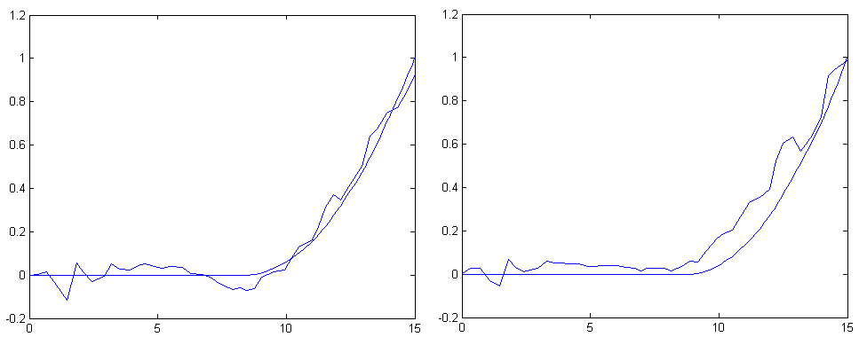
Ethanol Concentration
The data set on the left was the set used to train the neural network. The plot on the right shows the performance of the neural network on an unfamiliar data set. Correlation Coef. 0.7715

Slide 12
Triple-Variable Optimized
When a single variable (X, E or S) was optimized, the error greatly increased for the other outputs
Optimizing across all outputs increased run time, but substantially increased accuracy, particularly with metabolites.
The single-variable optimized network actually provided adequate results, but this is likely because for this particular system.
Additional tweaking of model required for better prediction of cell metabolism. (Initial variance reduction)

